Slide 1

SYSC 5108 – Deep Learning Image Recognition: Using Deep Neural Networks for Traffic Light Managment
By: Jon Menard

Slide 2


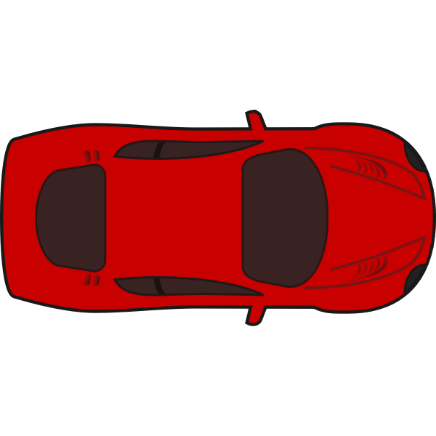
Motivation
Have you ever been stuck at a red light even though there is no traffic on the other road?
If there was a way to detect the presence of traffic, the lights could be change to optimize traffic flow
Notes:
Good Afternoon everyone, to begin I would like to introduce my motivation for this project. One thing I find very annoying is when Im driving and I get stopped by a red light connecting to a busy road, and I have to wait 2 or more minutes for the light to change, even though there is no traffic coming the other way. If there was a method to detect cars in the moving lanes, the lights could change when no cars are present.

Slide 3


Machine Learning – Image Recognition
Detecting Cars will be facilitated using image recognition
Car
Not a car
Notes:
In order to detect cars, image detection could be used to determine when a car on the road.

Slide 4

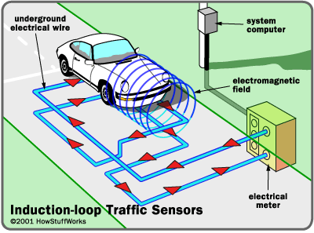
Why Image Recognition?
Cost Effective - an increasing number of traffic lights already have cameras
Easy to implement - no need to install magnetic sensing equipment under ground

Slide 5

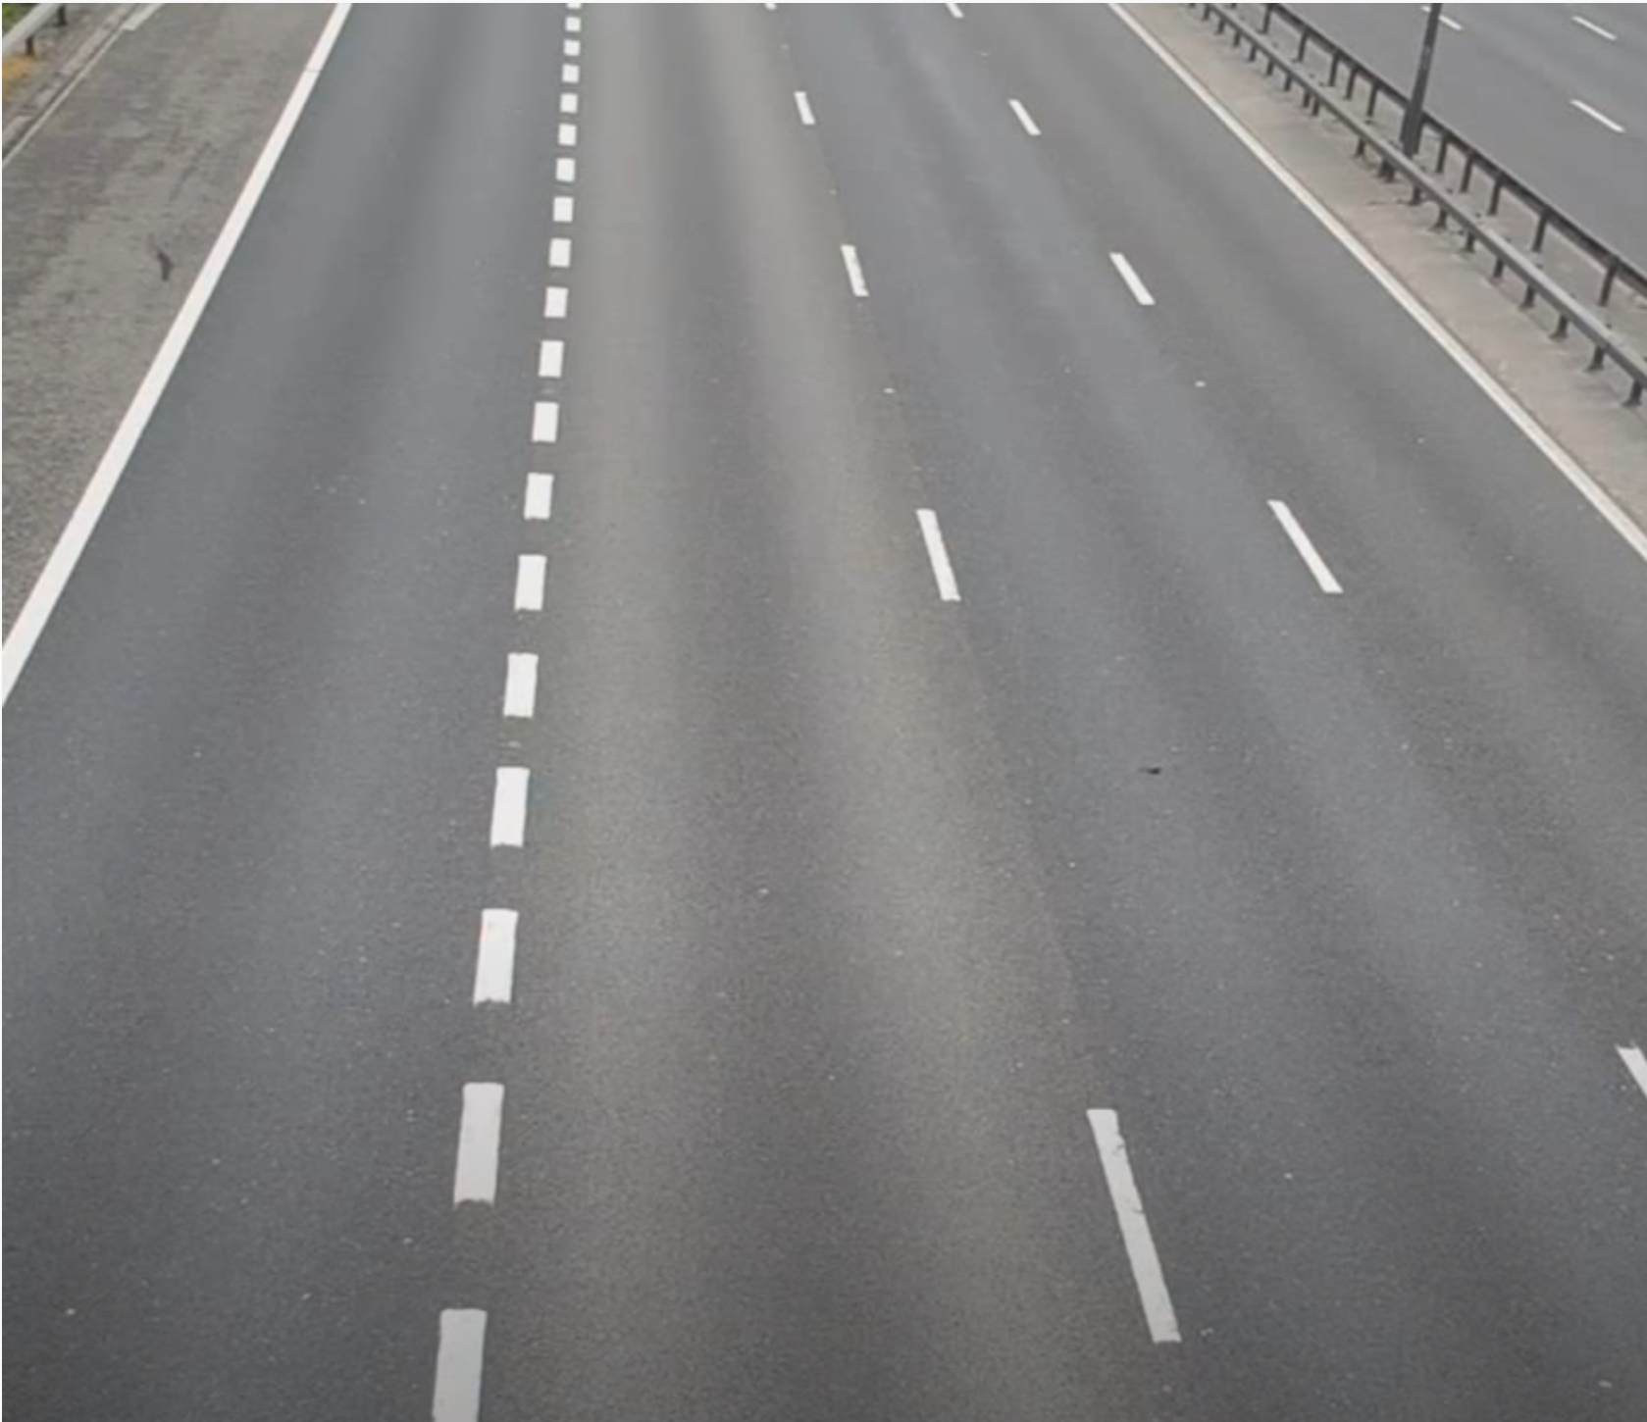
Goal
No car detected – safe to change light

Slide 6
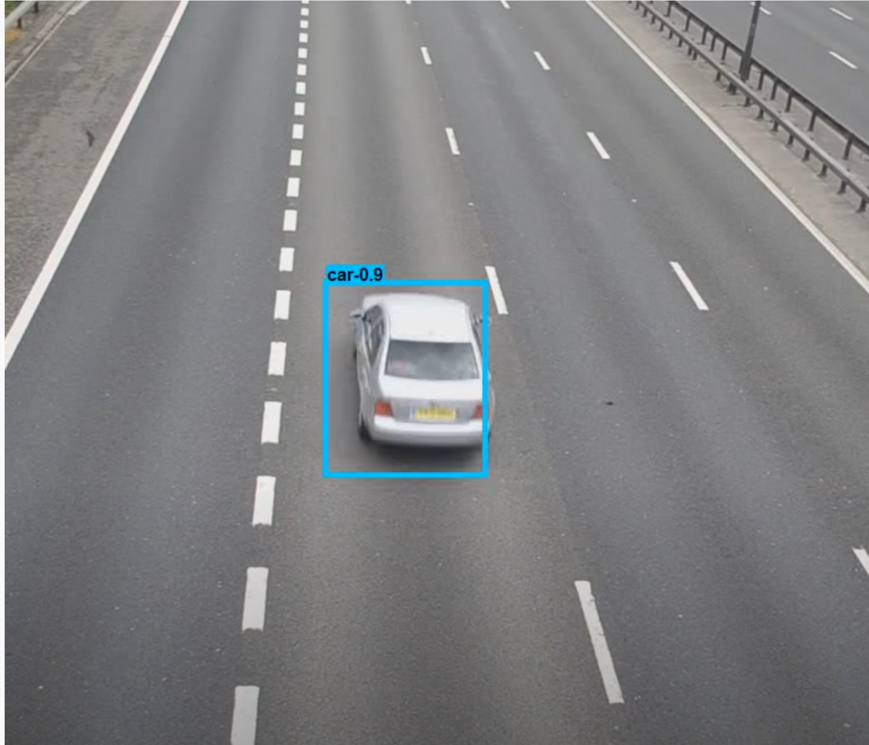
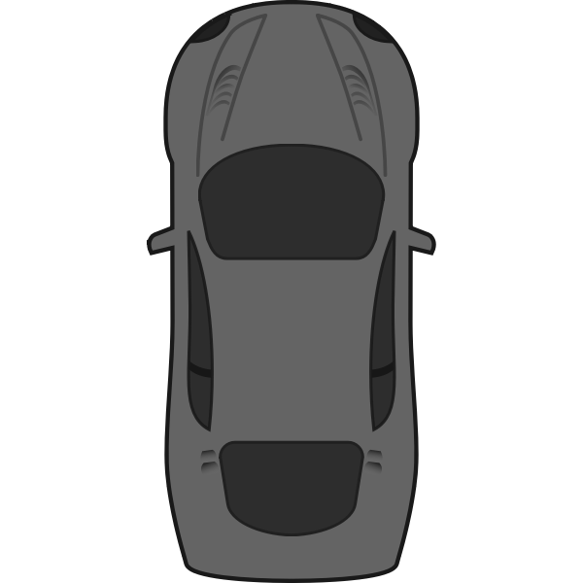
Goal
Car detected – not safe to change light

Slide 7
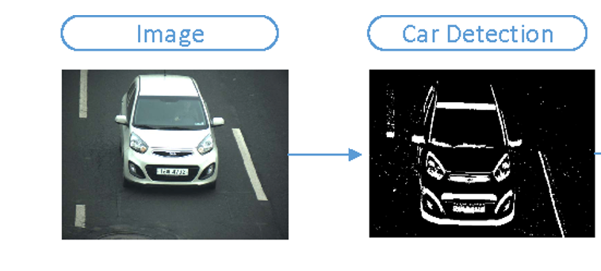
Convolution Neural Networks (CNN)
CNNs use multiple filters to detect patterns in an image
Each filter uses a separate kernel for identifying different features
CNNs are location insensitive, if a feature is in an image, it will be detected
Notes:
Recent studies have revealed that the optimum radio resource allocation in a future OFDMA‐based multi‐tier network is generally an NP‐hard problem, and hence computationally intractable [19, 20, 21].
Centralized methods – brute‐force, sub‐optimal, and heuristic-based– for solving the resource allocation problems in a dense network are not scalable.
Moreover, with the centralized approaches, the controller node could be a bottleneck due to the requirement for global information to manage all the network tiers: small cells, D2D/M2M UEs, and so on. And this requires a lot of signaling overhead.
On the other hand, distributed or semi‐distributed approaches with low signaling overhead are suitable for dense multi‐tier networks, where multiple nodes can perform resource allocation independently
where the network nodes, such as SBSs and P2P nodes, perform resource allocation independently or with the minimal assistance of the central controllers: the MBSs. In addition, the distributed methods may turn out to be efficient solutions for practical implementations due to the reduced computational complexity.

Slide 8
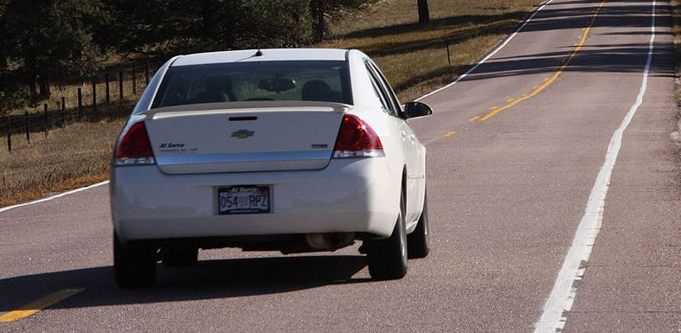
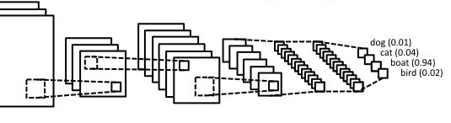
Pooling
Pooling combines local maximums in small areas, eliminating extra information.
Input | Convolution | Pooling | Convolution | Pooling | Fully Connected | Fully Connected | Output Predictions
Kernel
Kernel
Kernel
Bike
Truck
Motorcycle
Car
Notes:
Recent studies have revealed that the optimum radio resource allocation in a future OFDMA‐based multi‐tier network is generally an NP‐hard problem, and hence computationally intractable [19, 20, 21].
Centralized methods – brute‐force, sub‐optimal, and heuristic-based– for solving the resource allocation problems in a dense network are not scalable.
Moreover, with the centralized approaches, the controller node could be a bottleneck due to the requirement for global information to manage all the network tiers: small cells, D2D/M2M UEs, and so on. And this requires a lot of signaling overhead.
On the other hand, distributed or semi‐distributed approaches with low signaling overhead are suitable for dense multi‐tier networks, where multiple nodes can perform resource allocation independently
where the network nodes, such as SBSs and P2P nodes, perform resource allocation independently or with the minimal assistance of the central controllers: the MBSs. In addition, the distributed methods may turn out to be efficient solutions for practical implementations due to the reduced computational complexity.

Slide 9

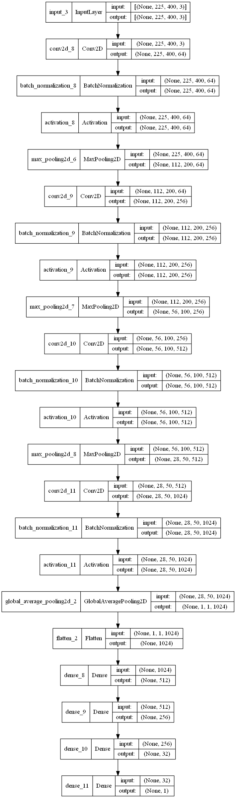






Model Architecture
Input 225 X 400 X 3
3 channels for RGB, normalized between 0 and 255
225 x 400 for size of image
1 output; < 0.5 = no car, >= 0.5 = car
Loss function – binary cross entropy
4X
Sample Training Set
Car
Car
Car
Car
Car
No Car
Berkley Deep Drive - https://bdd-data.berkeley.edu
Notes:
Can learn the implied characteristics of the environment
Avoid the exhaustive search in the action space of the problem
And can provide near-optimal solutions to maximize the end-user performance (SINR and data rate). This is particularly useful in cases with non-convex optimization problems.

Slide 10

Results
Feature extraction from 1st convolution layer
Notes:
The task of reinforcement learning is usually modeled as a Markov Decision Process (MDP) (however, state space, explicit transition probability and reward function are not necessarily required)
A policy Pi maps a state ton action a~Pi(s)
Gamma is the discount factor and has a value between [0; 1]
Long-term cum discounted reward, which is expected value of R for the policy Pi over all time steps.
The larger gamma , the more weight is given to rewards in future time steps: the objective becomes more “farsighted.” If = 1, rewards from every time step are weighted equally.
One important assumption underlying the reinforcement learning problems discussed in this book is that agents do not have access to the transition function, P(st+1 | st; at), or the reward function, R(st; at; st+1). The only way an agent can get information about these functions is through the states, actions, and rewards it actually experiences in the environment—that is, the tuples (st, at, rt).
The return R(taw) is the sum of discounted rewards over all time steps t = 0, …, T). The objective J( ) is the return averaged over many episodes. The expectation accounts for stochasticity in the actions and the environment—that is, in repeated runs, the return may not always end up the same. Maximizing the objective is the same as maximizing the return.

Slide 11
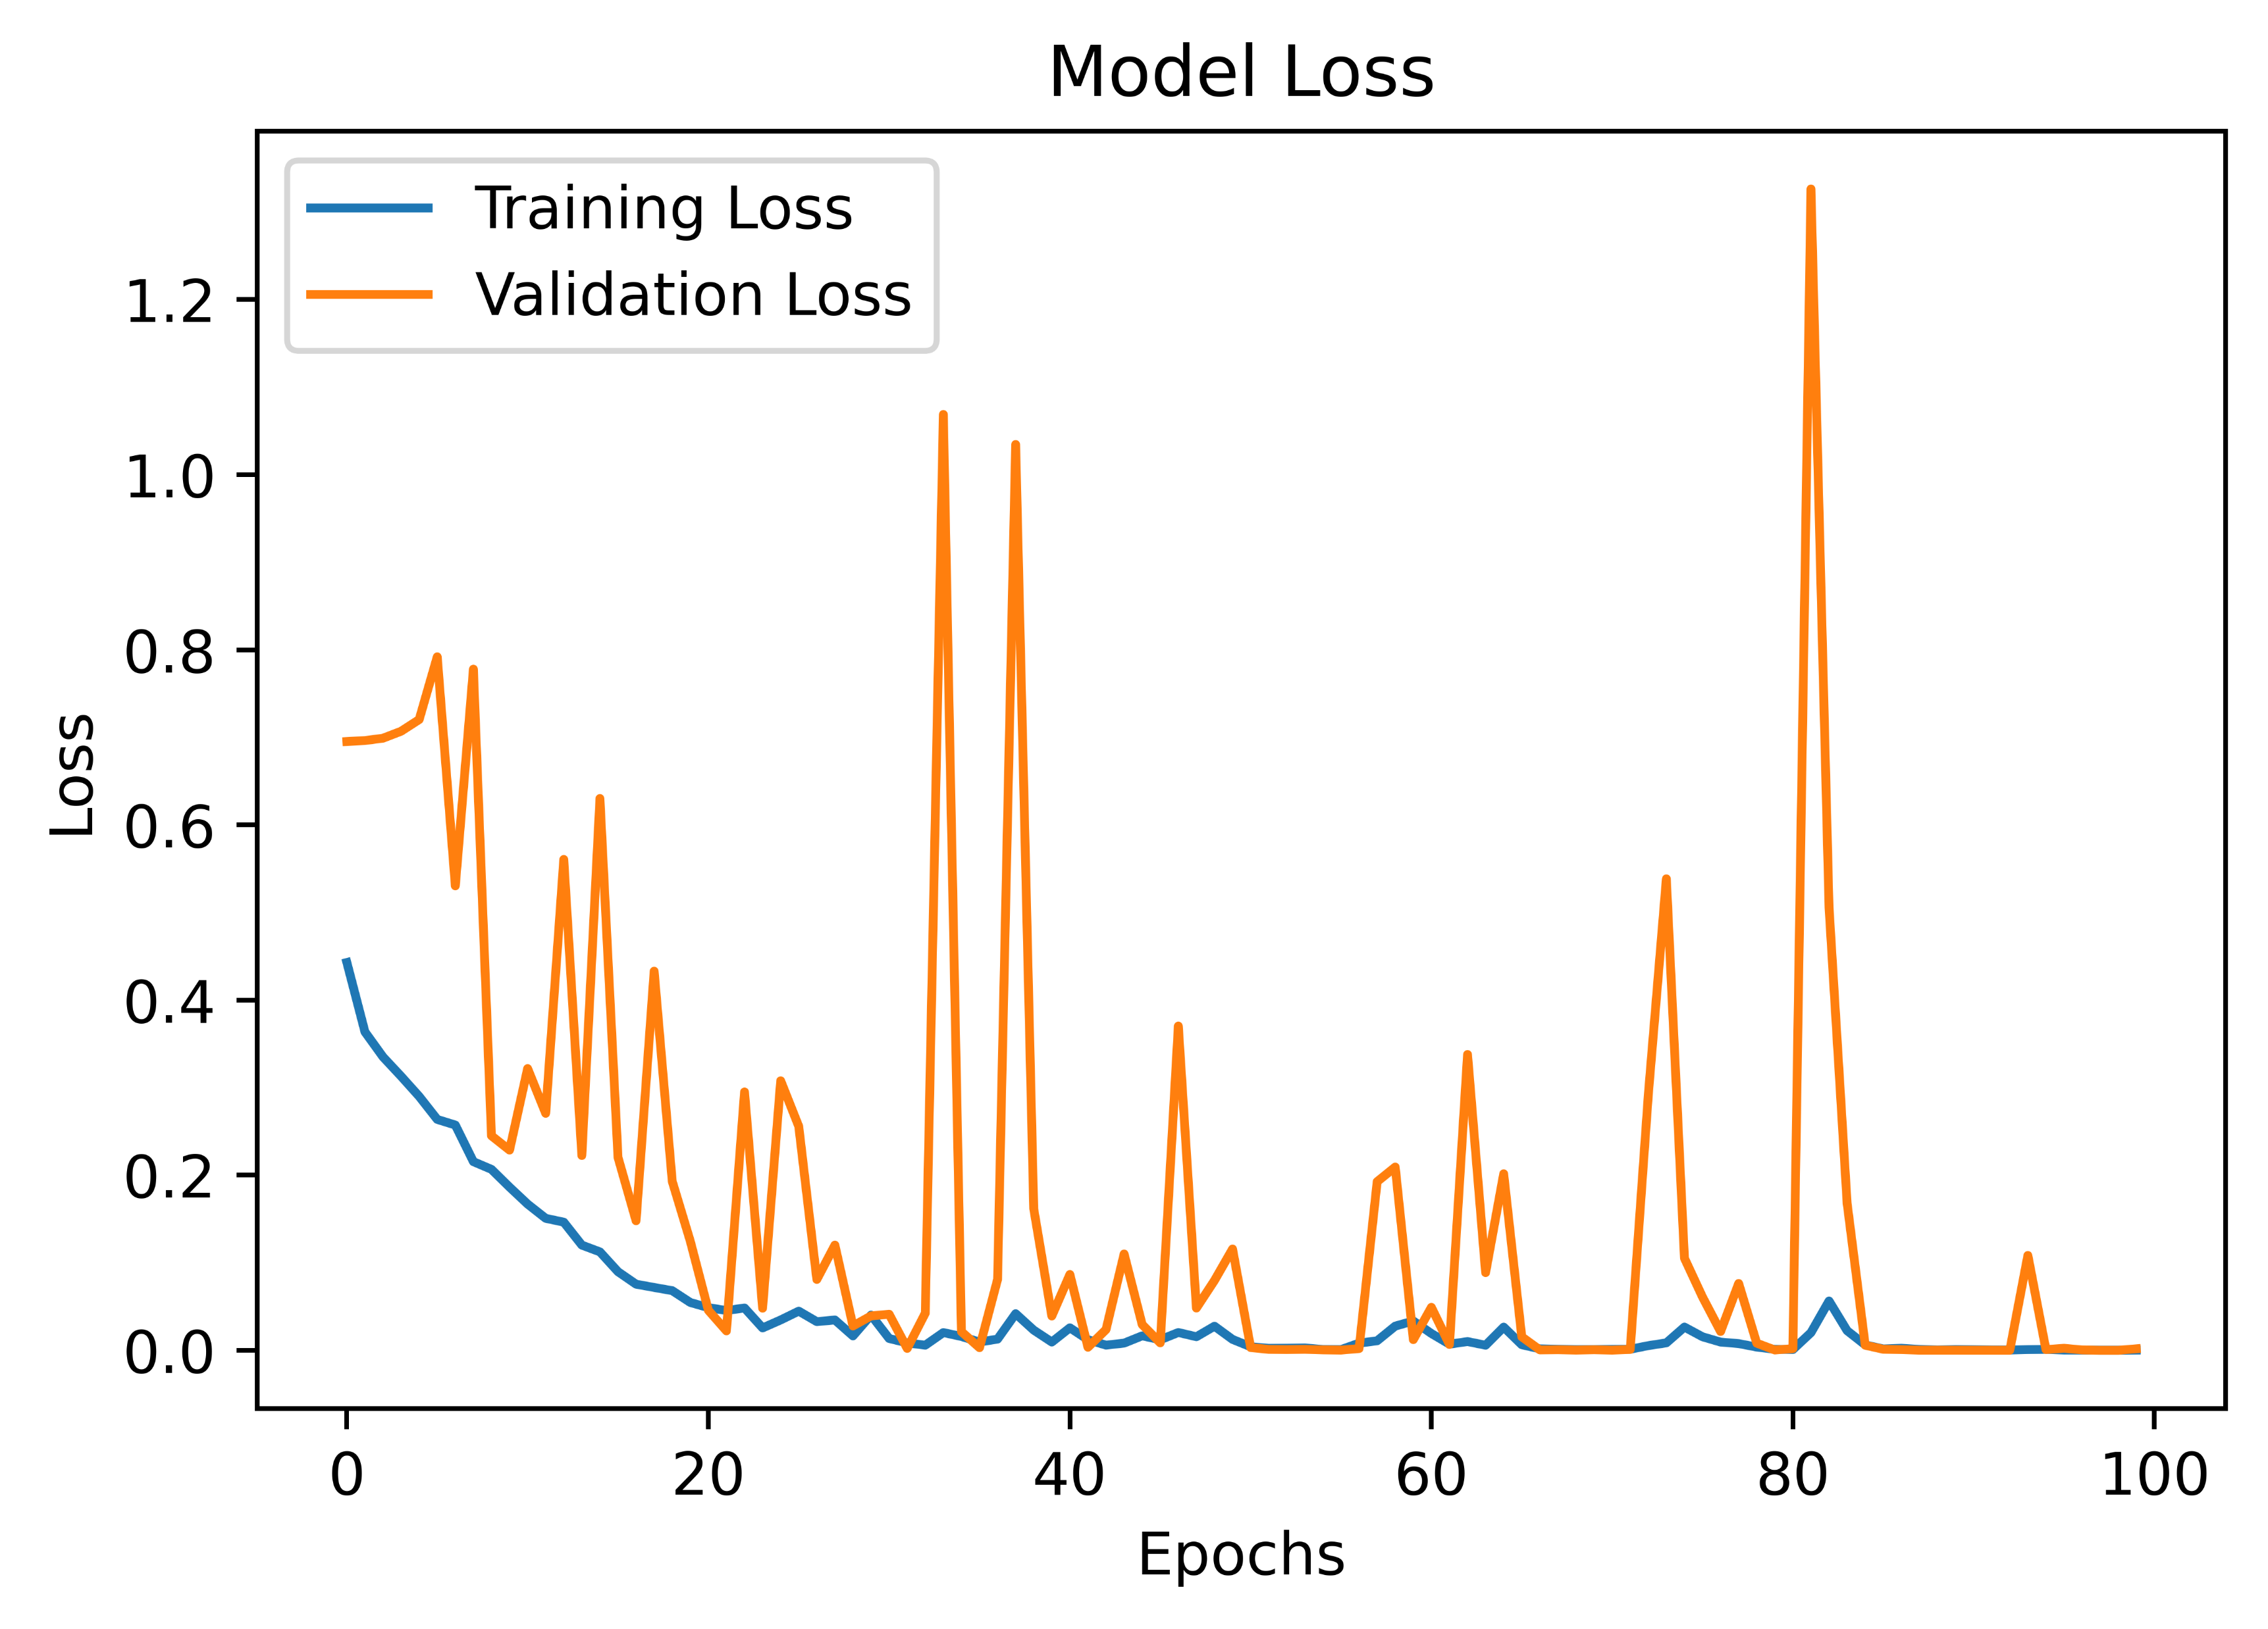
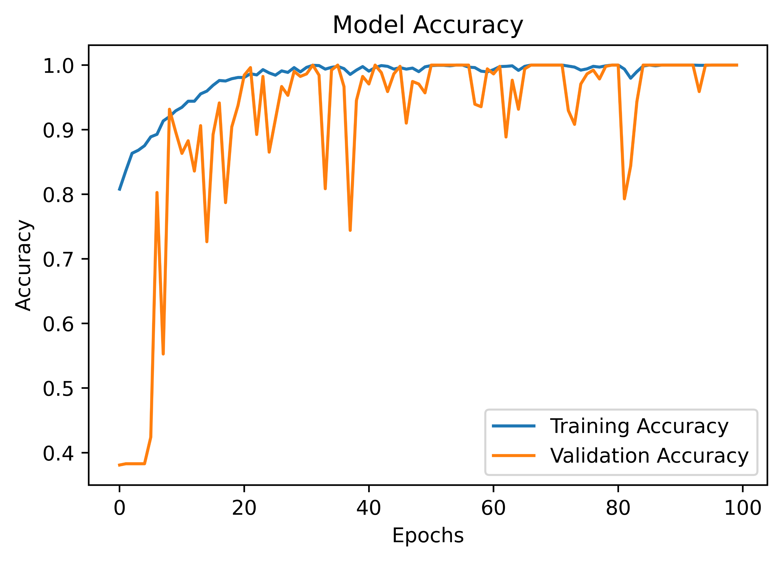
Results
Feature extraction from 1st convolution layer
100% Validation Accuracy
100% Validation Accuracy
Notes:
The task of reinforcement learning is usually modeled as a Markov Decision Process (MDP) (however, state space, explicit transition probability and reward function are not necessarily required)
A policy Pi maps a state ton action a~Pi(s)
Gamma is the discount factor and has a value between [0; 1]
Long-term cum discounted reward, which is expected value of R for the policy Pi over all time steps.
The larger gamma , the more weight is given to rewards in future time steps: the objective becomes more “farsighted.” If = 1, rewards from every time step are weighted equally.
One important assumption underlying the reinforcement learning problems discussed in this book is that agents do not have access to the transition function, P(st+1 | st; at), or the reward function, R(st; at; st+1). The only way an agent can get information about these functions is through the states, actions, and rewards it actually experiences in the environment—that is, the tuples (st, at, rt).
The return R(taw) is the sum of discounted rewards over all time steps t = 0, …, T). The objective J( ) is the return averaged over many episodes. The expectation accounts for stochasticity in the actions and the environment—that is, in repeated runs, the return may not always end up the same. Maximizing the objective is the same as maximizing the return.

Slide 12






Demo
Notes:
The task of reinforcement learning is usually modeled as a Markov Decision Process (MDP) (however, state space, explicit transition probability and reward function are not necessarily required)
A policy Pi maps a state ton action a~Pi(s)
Gamma is the discount factor and has a value between [0; 1]
Long-term cum discounted reward, which is expected value of R for the policy Pi over all time steps.
The larger gamma , the more weight is given to rewards in future time steps: the objective becomes more “farsighted.” If = 1, rewards from every time step are weighted equally.
One important assumption underlying the reinforcement learning problems discussed in this book is that agents do not have access to the transition function, P(st+1 | st; at), or the reward function, R(st; at; st+1). The only way an agent can get information about these functions is through the states, actions, and rewards it actually experiences in the environment—that is, the tuples (st, at, rt).
The return R(taw) is the sum of discounted rewards over all time steps t = 0, …, T). The objective J( ) is the return averaged over many episodes. The expectation accounts for stochasticity in the actions and the environment—that is, in repeated runs, the return may not always end up the same. Maximizing the objective is the same as maximizing the return.

